Slide 1
Sprint Review 3
(Results)
BY Malcolm Howard & Fortunato Hernandez

Slide 2
Research Question
How does AI presents players effectiveness on the soccer/football fields?

Slide 3
Objective of this Sprint Review
Display our results from the research
Find a final direction for our sprint reviews

Slide 4
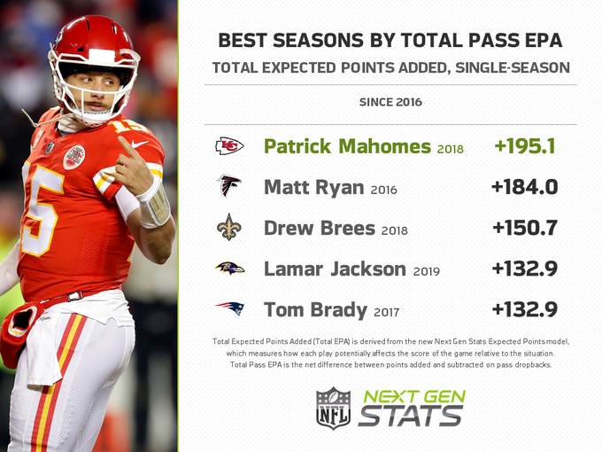
Next Gen Stats: EPA
EPA is the expected points added by a quarterback per play. This measures a players value on the field for a team. 4 of the 5 players shown have went on to win MVP for the year.

Slide 5
Next Gen Stats: Route Recognition
Route recognition is a way we can classify routes by the type it is and helps with player-tracking data.
This stat is mainly targeted for the WR position but also includes the Tight Ends and Runningbacks
There are 15 type of routes they measure:
Wideout routes(10) : Screen, flat, slant, crossing, out, in, hitch, corner, post, go
Backfield routes(5): Screen, flat, angle, out, wheel

Slide 6
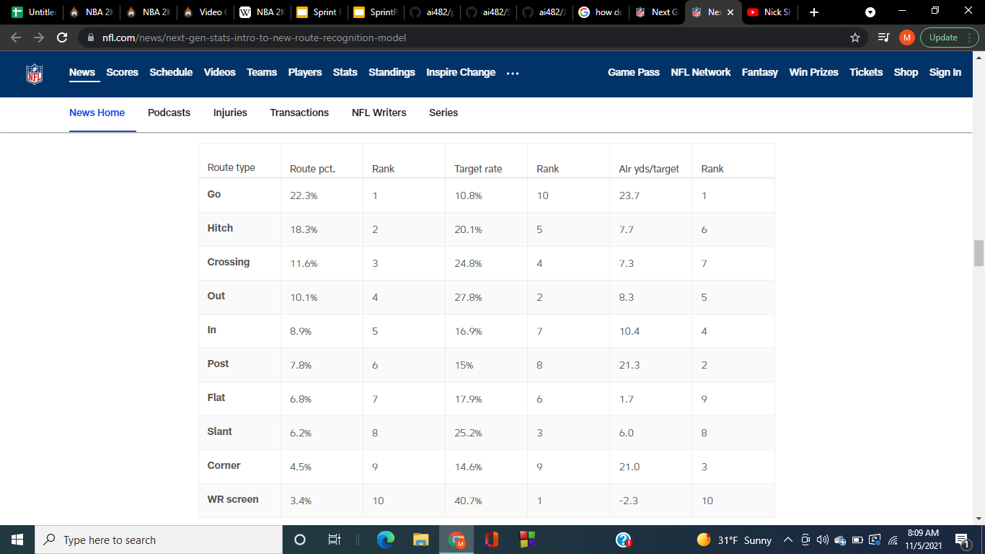
Route Recognition cont.

Slide 7

Route Recognition cont. (production)

Slide 8
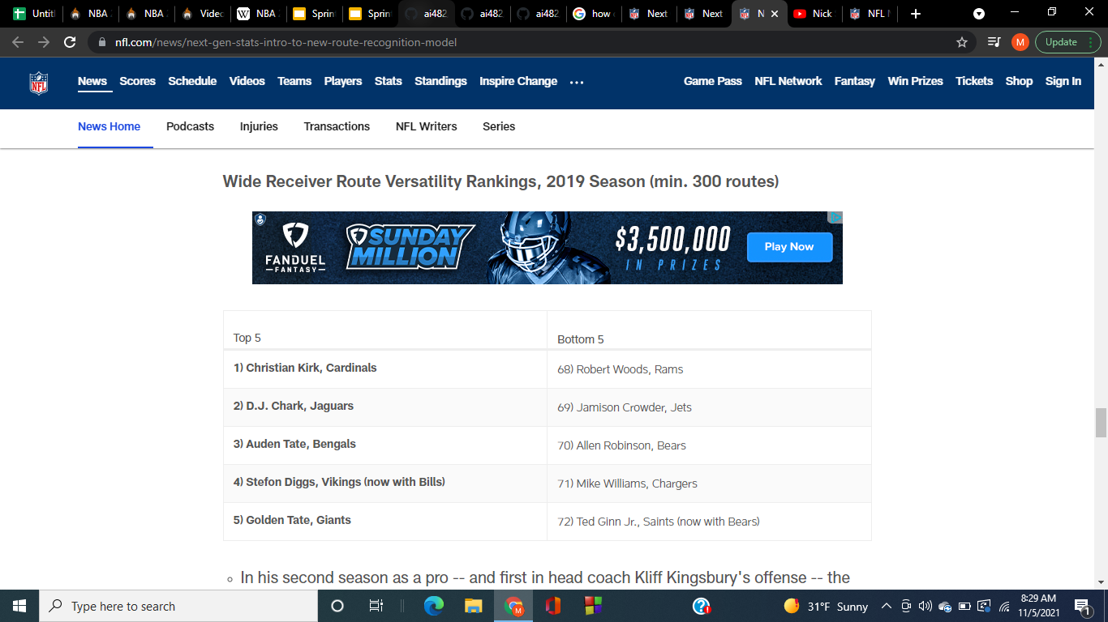
Route Recognition cont. (variation)

Slide 9
Route Recognition
https://www.nfl.com/videos/nick-shook-introduces-route-recognition-to-next-gen-stats

Slide 10
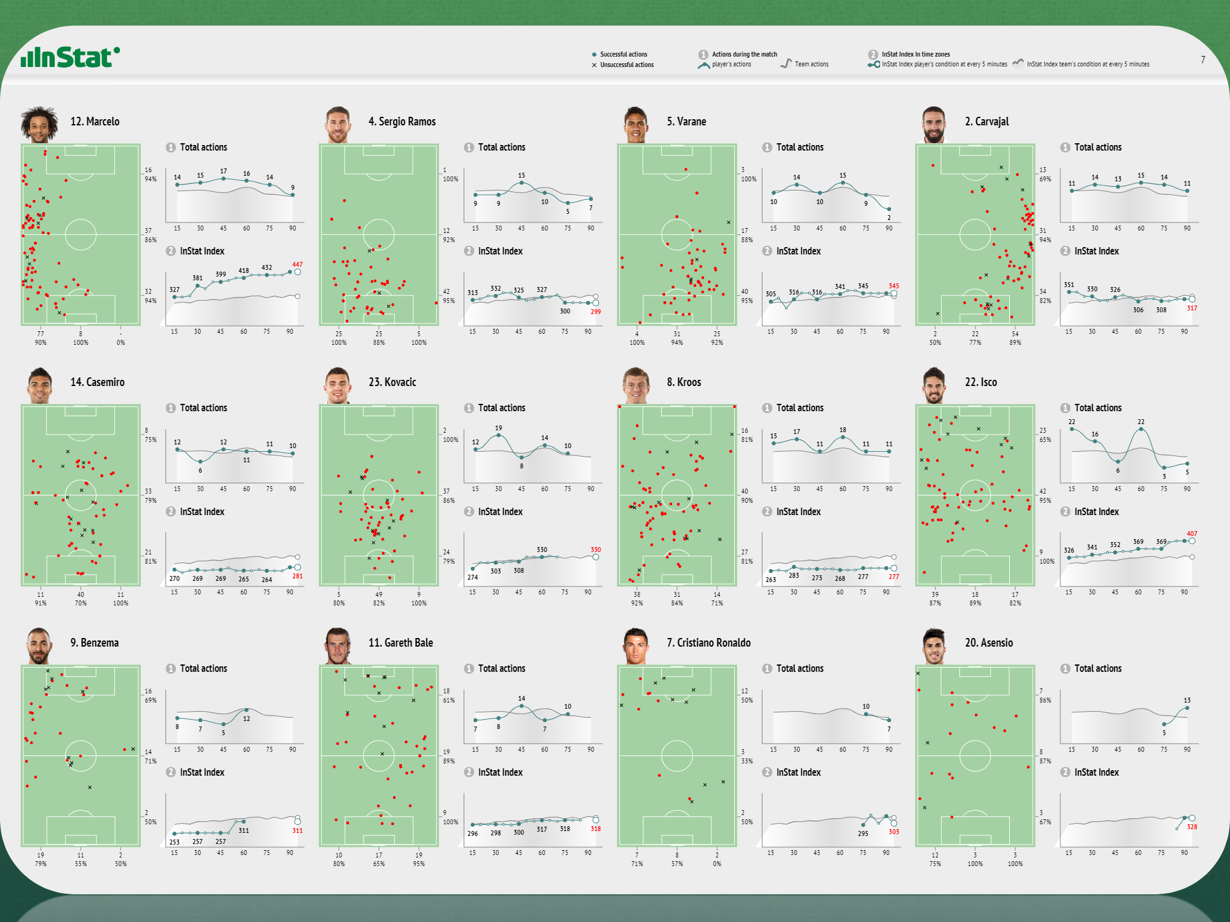
Instat
With Instat, soccer players can see how they are performing in games and practice. This data will help them to know if they are being effective on the field.

Slide 11
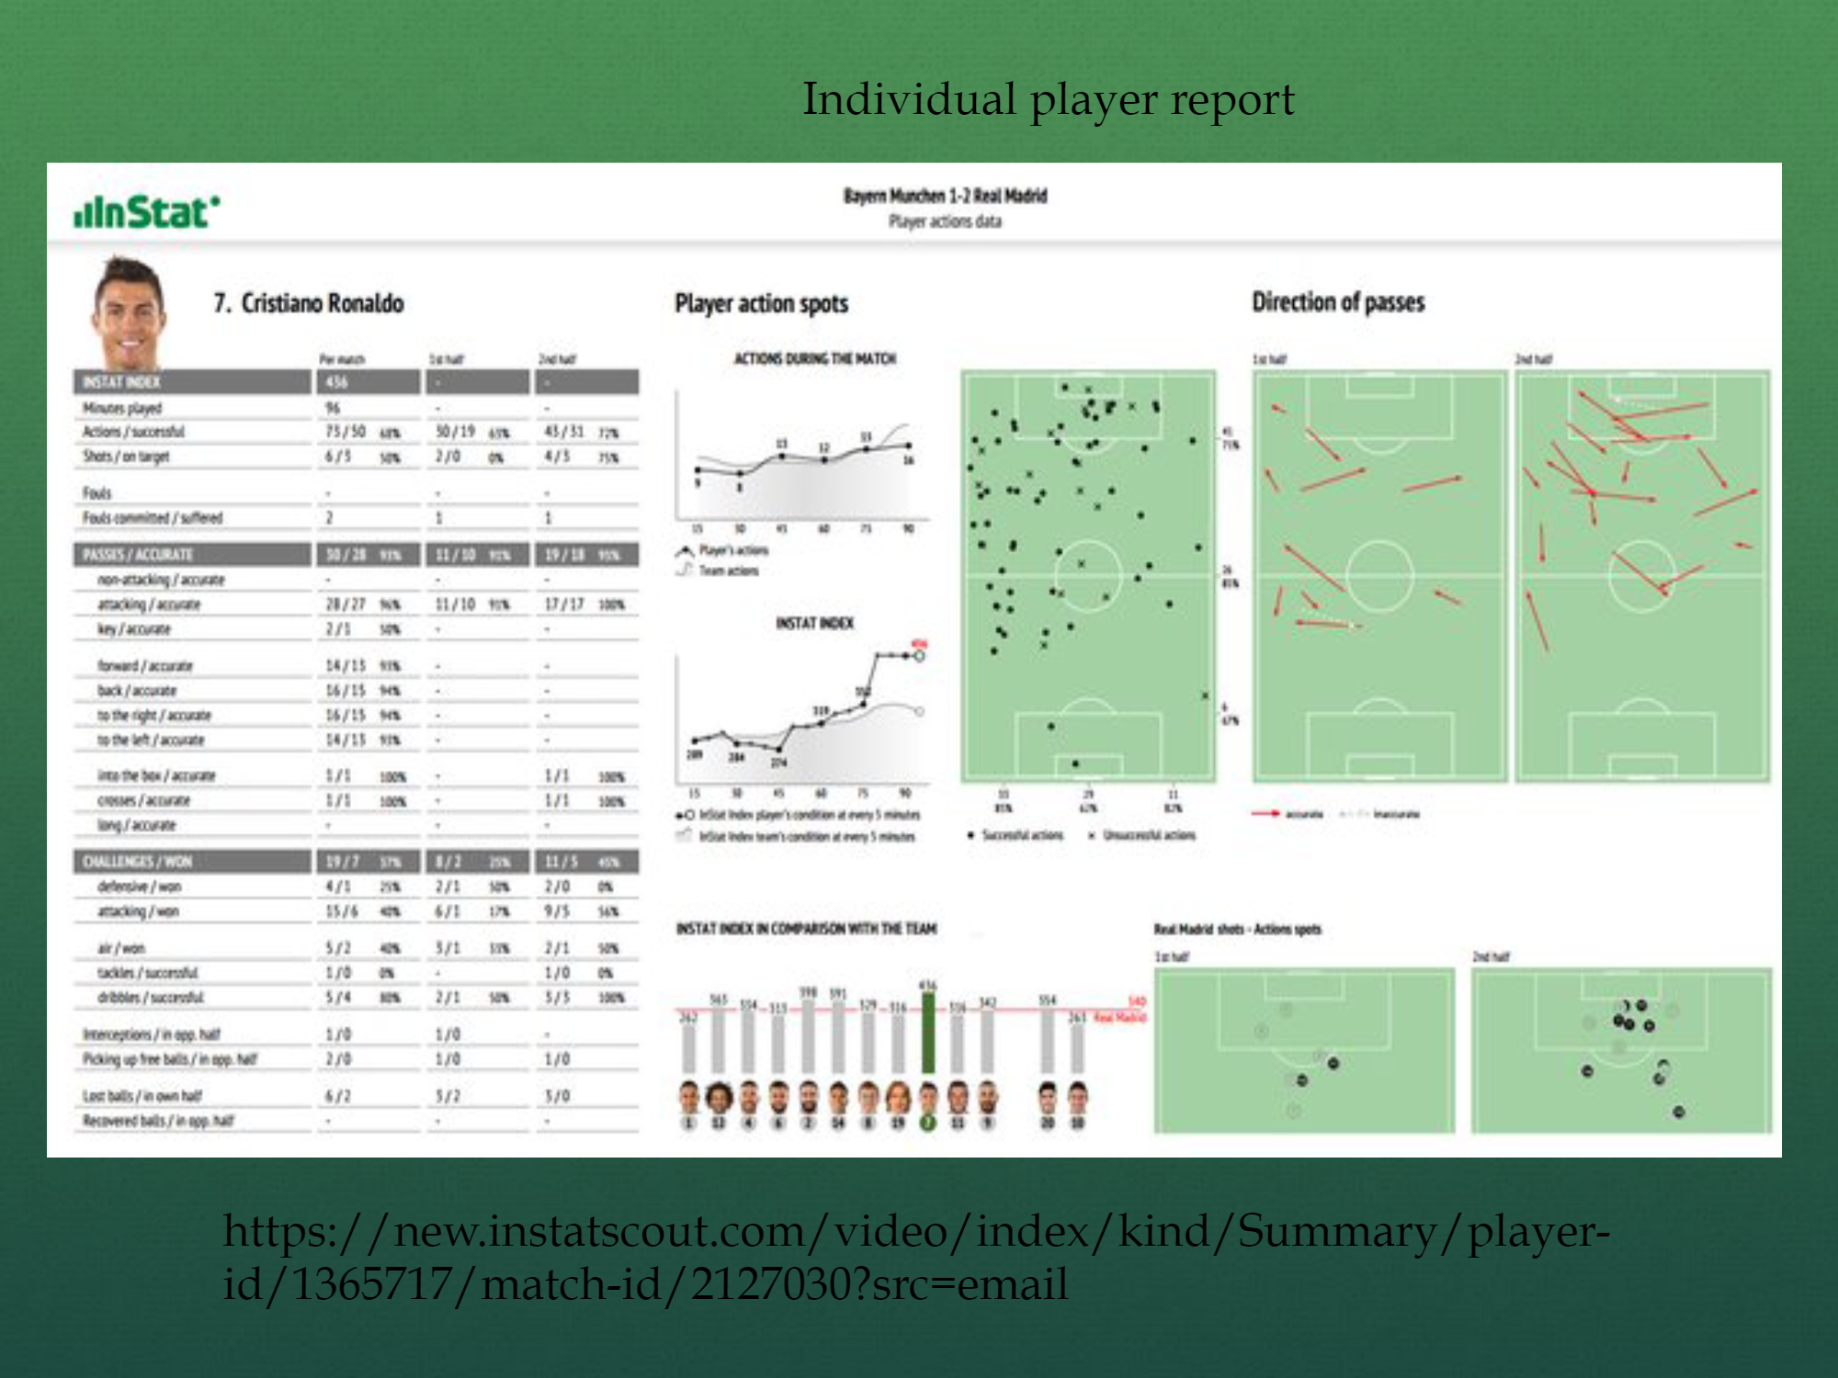

Slide 12

Olocip
Olocip is a predictive performance analysis platform.

Slide 13
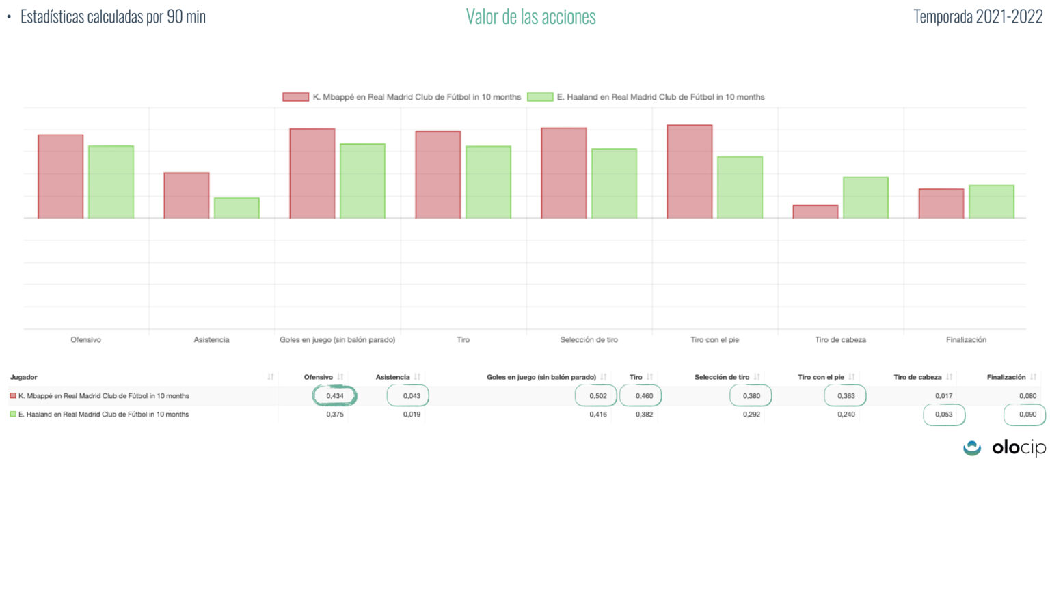

Slide 14
What did we achieve?
What will we do for the next sprint review?
We found a research question that best fits us and the easiest to do research on.
Do a little more research and bring all our information together
Decide whether will we stick with using existing data or create our own
Create the final product

Slide 15
Work Cited
The Next Gen Stats Analytics Team. “Next Gen Stats: New Advanced Metrics You NEED to Know for the 2020 NFL Season.” NFL.Com, Mike Band, 19 Nov. 2020, www.google.com/url?q=https://www.nfl.com/news/next-gen-stats-new-advanced-metrics-you-need-to-know-for-the-2020-nfl-season&source=gmail&ust=1636202174429000&usg=AFQjCNEy3roaAtpw4nV9qcBccuWD2BzjCQ.

